Slide 1
Research Data Management
From Daily Life in a Lab
Research Data Management for Researchers (Introduction)

Slide 2
Have you ever had trouble or confusion managing your research data?
Research data are handled in laboratories on a daily basis. Depending on how they are managed, they can greatly affect the progress of a research and the reliability of the results, and even a small mistake in their handling can lead to serious incidents. However, setting and following some basic rules will lead to better-quality research and its efficient and smooth sharing.
Notes:
Have you ever had trouble or confusion managing your research data?
Research data are handled in laboratories on a daily basis. Depending on how they are managed they can greatly affect the progress of a research and the reliability of the results and even a small mistake in their handling can lead to serious incidents. However setting and following some basic rules will lead to better-quality research and its efficient and smooth sharing.

Slide 3
Episode 1
Organization and documentation of data
Notes:
For example, have you ever had this happen in your lab?

Slide 4
Keep the data and results of the experiment in a shared folder on the server.
Yes!
Notes:
Professor : Keep the data and results of the experiment in a shared folder on the server.
Students ：Yes!

Slide 5
One month later.
Notes:
One month later.

Slide 6
Let’s see.
Wow, this is...
Notes:
Let’s see. Wow, this is...

Slide 7
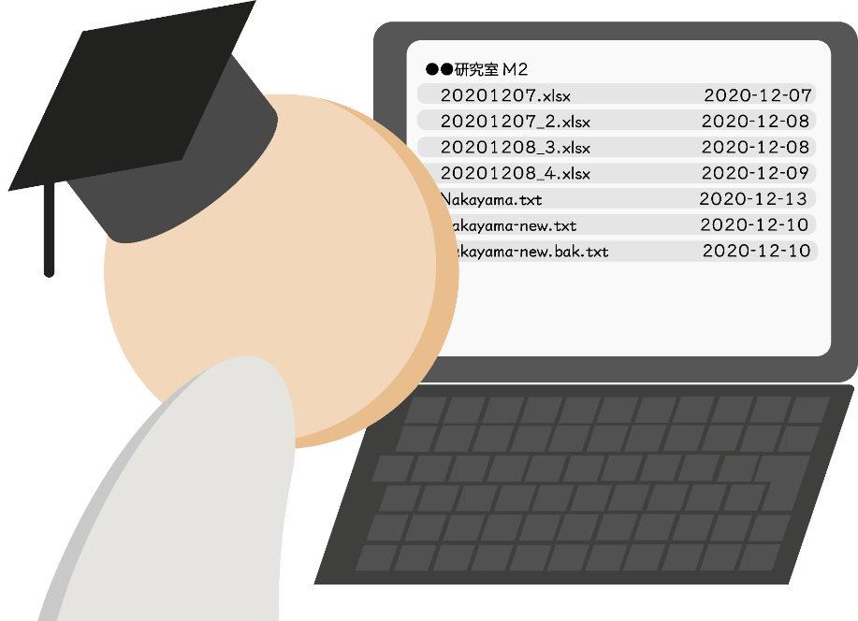
Do I have to check the contents of all folders?
Today, my precious research time was cut short again...
Notes:
Do I have to check the contents of all folders?
Today, my precious research time was cut short again...

Slide 8
To use, share and reuse research data effectively and efficiently, it is necessary to
Establish rules for file and folder naming and folder structures
Document the context
Notes:
To use, share and reuse research data effectively and efficiently, it is necessary to establish rules for file and folder naming and folder structures and document the context.

Slide 9
By doing so,
Multiple people can work together without disruption.
It is easier to find files.
The context can be maintained even when moving to another platform
It is possible to differentiate between various versions
There are several advantages to this, such as saving time and improving the efficiency of research.
Notes:
By doing so, there are several advantages to this, such as saving time and improving the efficiency of research.

Slide 10
Episode 2
Ensuring the security of research data
(security and backup)
Notes:
For example, something like this seems to have happened somewhere.

Slide 11
On a collaborative research for this term, share files on G-Drive.
バイト先の先輩
Sir, I have finished processing the data for my assignment and uploaded it to the folder http://……
Notes:
Professor : On a collaborative research for this term, share files on G-Drive.
Student A ：Sir, I have finished processing the data for my assignment and uploaded it to the folder. The URL is …

Slide 12
Hmm? Hasn’t the email I just received been sent to the wrong address?
Ugh! I'm sorry! Please delete that email immediately!
I sent it to the address that was recommended to me.
Notes:
Student B : Hmm? Hasn’t the email I just received been sent to the wrong address?
Student A : Ugh! I'm sorry! Please delete that email immediately!
Student A : (I sent it to the address that was recommended to me.)

Slide 13
Oh,no!
I forgot to set the access permissions...
If these were personal information data, I would have had to hold a press conference to apologize before processing.
Sir, I'm sorry, I sent it to the wrong person earlier...
Notes:
Student A : Sir, I'm sorry, I sent it to the wrong person earlier...
Professor : Oh,no!
Professor : (I forgot to set the access permissions... If these were personal information data, I would have had to hold a press conference to apologize before processing.)

Slide 14
It’s important research data, so let’s be prepared for emergencies.
Security
In addition to the capacity, cost, and ease of use, considering reliability and safety when selecting an appropriate storage location
Ensuring appropriate security, such as setting access privileges
Establishing procedures and training to prevent human error
Notes:
It’s important research data, so let’s be prepared for emergencies. Considering reliability and safety, ensuring appropriate security, and establishing procedures and training to prevent human error.

Slide 15
Backup
Using software to create regular backups, instead of doing it manually
Selecting an appropriate backup method, considering the disk space and time required
In consideration of disasters, placing backups in multiple locations
Notes:
Using software to create regular backups, selecting an appropriate backup method and in consideration of disasters, placing backups in multiple locations.

Slide 16
Episode 3
Disclosure of the evidence data of
research outputs
Notes:
This is a real case.

Slide 17
Please deposit the evidence data of your research outputs into a reliable repository.
Publisher
Yes Okay, I am sure there is a shared folder provided by the university, and I am going to put it on the web.
The URL is
http://archive.iii.XXXX-u.ac.jp/public/....
No no no. That account will be deleted when you graduate. Your personal account folder is not a “repository.”
Notes:
Publisher : Please deposit the evidence data of your research outputs into a reliable repository.
Student : Yes Okay, I am sure there is a shared folder provided by the university, and I am going to put it on the web.
Student : The URL is ....
No no no. That account will be deleted when you graduate. Your personal account folder is not a “repository.”

Slide 18
Disclosing the evidence data of your research output has become a critical issue in recent years.
Each publisher has established a data policy. Many of them require that the data be placed in a reliable repository, and an increasing number of them require that the data be disclosed.
Even if not requested at the time of submission, disclosure may be requested later, and in some cases, papers have been withdrawn from publication because the evidence data were not properly presented.
Notes:
Disclosing the evidence data of your research output has become a critical issue in recent years. Many of data policies require that the data be placed in a reliable repository, and an increasing number of them require that the data be disclosed.

Slide 19
Valid options include repositories recommended by publishers and disciplinary repositories. However, if you are having trouble, do not make a decision on your own but ask a senior researcher or consult the library. The Kyushu University Institutional Repository (“QIR”) is being prepared for the disclosure of evidence data.
Notes:
The Kyushu University Institutional Repository (“QIR”) is being prepared for the disclosure of evidence data.

Slide 20
Episode 4
Inheritance of research data
in the laboratory
Notes:
Here is an example from a professor.

Slide 21
Sorry, I cannot find the time. I will do it on graduation day!
Before you graduate, make sure you have all your data in a folder!
Notes:
Professor : Before you graduate, make sure you have all your data in a folder!
Student : Sorry, I cannot find the time. I will do it on graduation day!

Slide 22
One month later.
Notes:
One month later.

Slide 23
I would like to use some of these data. Let’s see...
Hmm... I can’t find them.
Where are they?
Notes:
I would like to use some of these data. Let’s see...
Hmm... I can’t find them.
Where are they?

Slide 24
I can’t find them. Do you have the original data?
I already bought a new computer. The old one was discarded.
In the end, I had to process the data from scratch
according to his thesis.
Notes:
Professor : I can’t find them. Do you have the original data?
Student : I already bought a new computer. The old one was discarded.
Professor : (In the end, I had to process the data from scratch according to his thesis.)

Slide 25
To avoid unplanned loss of important data, rules are established in laboratories for storing data upon graduation or transfer.
The inheritance of research data is of utmost importance to university laboratories.
Notes:
To avoid unplanned loss of important data, rules are established in laboratories for storing data upon graduation or transfer.

Slide 26
Episode 5
Long-term storage of research data

Slide 27
Please disclose the evidence data from the experiment shown in Figure 5 of Paper A, published in 2015.
As I recall, this part was written by
Professor N of U of M at ...
Notes:
Publisher : Please disclose the evidence data from the experiment shown in Figure 5 of Paper A, published in 2015.
Assistant Professor : As I recall, this part was written by Professor N...

Slide 28
Professor N,
do you have those data?
Yeah, I left them on the server at my former lab at K University.
Notes:
Assistant Professor : Professor N, do you have those data?
Professor N : Yeah, I left them on the server at my former lab at K University.

Slide 29
Excuse me about the data that Professor N left your lab’s server...
I have moved the old ones to my hard drive, so I will try to find them.
Oops! ... I’d put it in the back of the rack, and my hard drive is stuck!
...all is not well...
Notes:
Assistant Professor : Excuse me about the data that Professor N left your lab’s server...
Lab at K University : I have moved the old ones to my hard drive, so I will try to find them.
Lab at K University : Oops! ... I’d put it in the back of the rack, and my hard drive is stuck!

Slide 30
The university’s “Guidelines for Research Data Storage” state that in principle, the retention period for research data, such as experimental notes, numerical data, images, and other “materials,” is 10 years after the publication of the relevant paper. Researchers and principal investigators must explain the appropriateness of their research activities with scientific evidence and disclose research data regarding the results published on paper upon request. They will be held responsible for this even after moving or retiring.
Notes:
The university’s “Guidelines for Research Data Storage” state that in principle, the retention period for research data, such as experimental notes, numerical data, images, and other “materials,” is 10 years after the publication of the relevant paper. Researchers and principal investigators will be held responsible for this even after moving or retiring.

Slide 31
What researchers need to keep in mind
Store the data in a reliable storage facility so that they can be retrieved even after moving or leaving the company.
For long-term storage, choose an appropriate format and media.
Avoid formats that only work with commercial software.
Use a format that is widely used.
Notes:
What researchers need to keep in mind is as follows.

Slide 32
To avoid trouble...
A DMP should be devised.
The university’s “data policy” should be developed.
System infrastructure should be developed for research data management and support services for researchers in universities.
Notes:
To avoid trouble...
A DMP should be devised.
The university’s “data policy” should be developed.
System infrastructure should be developed.

Slide 33
DMP
What is a “Data Management Plan”(DMP)?
This is a plan for how data will be managed, stored, and released in accordance with the research plan.
Advantages of creating and operating a DMP:
Discourages sloppy file management and prevents problems
Avoids confusion about how to manage files
Avoids wastage of time on following up with the students
Allows more focus on the research
Major overseas granting agencies require submission of DMPs at the time of grant application, In Japan, as well, some large grants already require the submission of DMPs.
The Japanese government aims to introduce DMPs in all public research funds by FY2023*.
*Cabinet Office, "The 6th Science and Technology Innovation Basic Plan" (approved by the Cabinet on March 26, 2021)
Notes:
What is a “Data Management Plan”?
This is a plan for how data will be managed stored and released in accordance with the research plan.
Major overseas granting agencies require submission of DMPs at the time of the grant application. In Japan, as well, some large grants already require the submission of DMPs.

Slide 34
Total support for research data management at each stage of the research cycle
Consulting on research data
Publishing from
The repository
Reuse
DMP creation support
Data management plan
Publish
Research planning
Data management
education
Open data support
-Data Curation
-Publishing a repository
Research proposal
Store for
10 years
Collect/Create
Research data management service
Process
Providing
storage
Research
Providing a data
Management
infrastructure
Inherit
Analyse
Submit/Publish
Preserve
Support on disclosure of
The evidence data
Writing
Disclose evidence data
Share
Research data
management policy
Collecting and sharing the latest
information with researchers
Notes:
In addition, in order for researchers to properly manage research data, universities are required to have a system that provides total support for data management at each stage of the research cycle and a system infrastructure.

Slide 35
Example of research data services at the University of Illinois:
Stay up-to-date on data policies, resources, and best practices and share with researchers.
Know
Consult with the researchers on the creation and implementation of a data management plan.
Consult
Illinois Research Data Service (RDS)
Review
Review the data management plan.
Provide education on data management, documentation, and data publication.
Teach
Publish
Release research data from the Illinois Data Bank.
Kyushu University is currently considering a service system that provides complete support for research data management.
Notes:
This is an example of research data service in the University of Illinois. This concludes the explanation. Thank you for your time.

