Slide 1
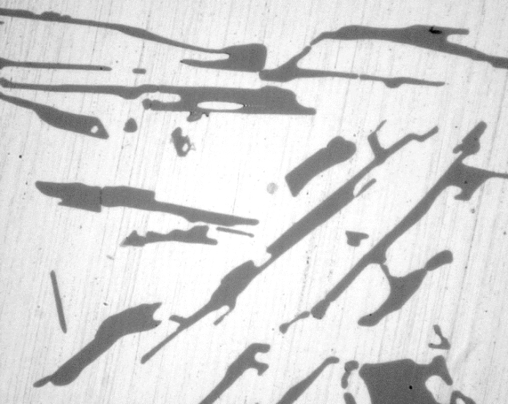
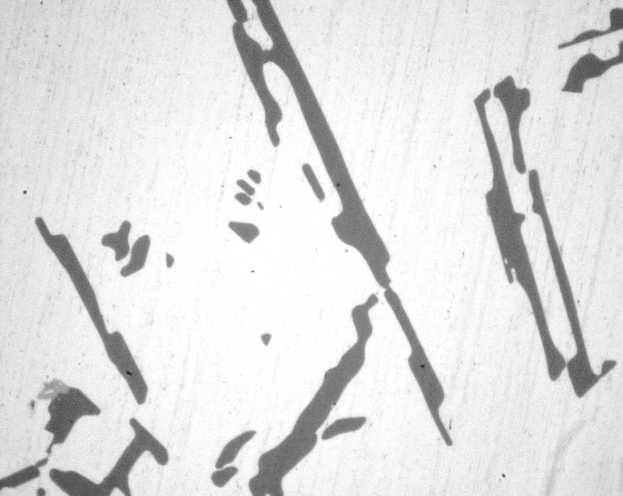
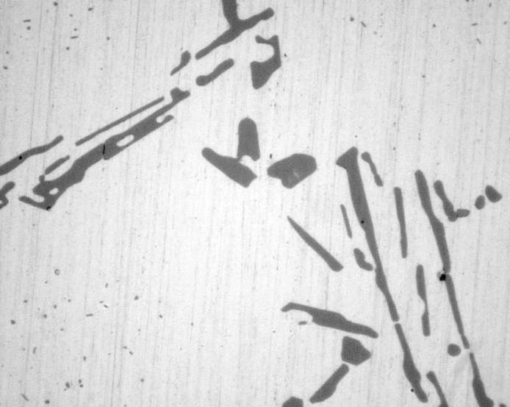
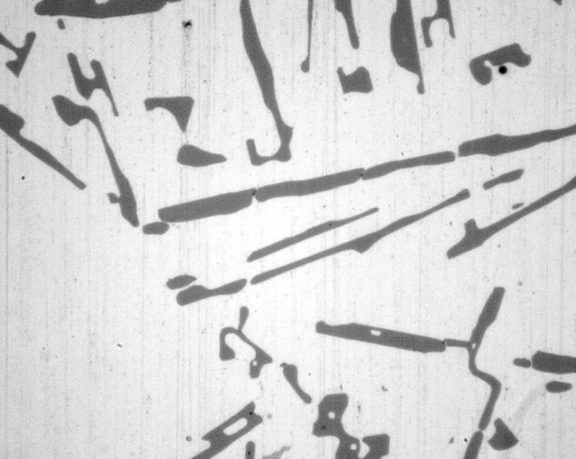
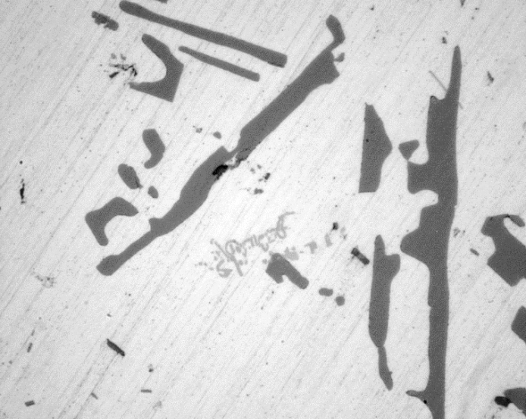
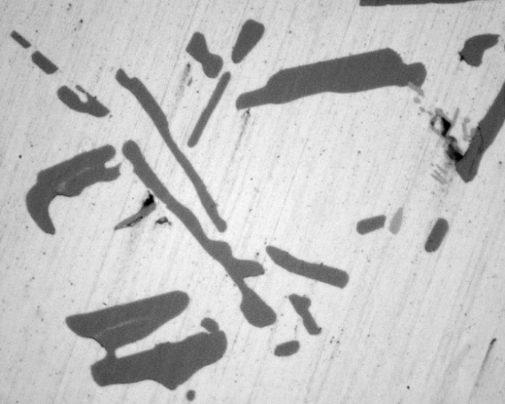
(a) 15 min
(b) 30 min
(c) 45 min
(d) 60 min
20 μm
(e) 120 min
(f) 480 min
Fig. 1 Optical microscope photo which indicates the change in Si particle shape depending on time of solid solution treatment from 120 minutes to 480 minutes by fluidized bed furnace.

Slide 2
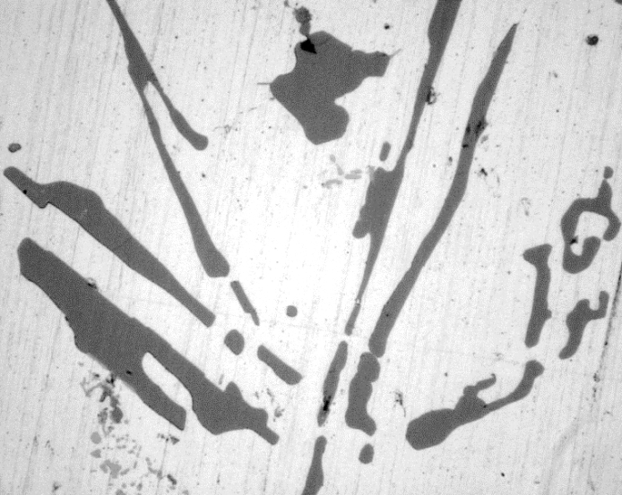
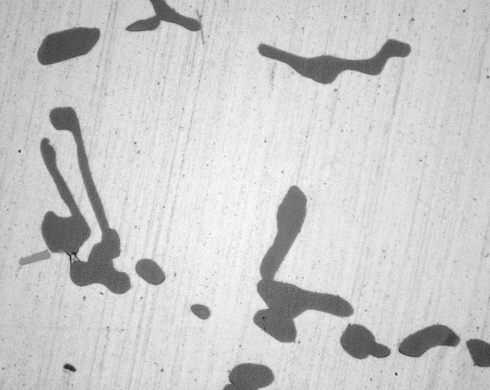
(a) 813 K
(b) 828 K
20 μm
(c) 843 K
Fig. 2 Optical microscope photo which indicates the change in Si particle shape depending on temperature of solid solution treatment by fluidized bed furnace.

Slide 3
110
100
90
Vickers hardness, H_{v}
0 s
80
3 s
9 s
70
18 s
30 s
60
45 s
10⁻²
10⁻¹
10⁰
10¹
10²
10³
Aging time, t / ks
(a) Changes in hardness during aging
280
4
260
3
σ_{UTS}, σ_{0.2} / MPa
RA (%), ε_{f}
2
240
1
σ_{UTS}
σ_{0.2}
ε_{f}
RA
0
220
0
10
20
30
40
50
Time, t / s
(b) Strength and ductility
Fig. 3 Effect of time delay between solid solution treatment and water cooling on mechanical properties in fluidized bed furnace.

Slide 4
110
100
90
Vickers hardness, H_{v}
15 min
80
30 min
45 min
70
60 min
120 min
60
480 min
10⁻²
10⁻¹
10⁰
10¹
10²
10³
Aging time, t / ks
(a) Changes in hardness during aging
300
4
270
3
240
σ_{UTS}, σ_{0.2} / MPa
RA (%), ε_{f}
210
2
180
1
σ_{UTS}
σ_{0.2}
ε_{f}
RA
150
0.5
5
0
Time, t / ks
50
(b) Strength and ductility
Fig. 4 Effect of solid-solution treatment time on mechanical properties in fluidized bed furnace.

Slide 5
16
Average diameter
0.10
14
Volume fraction
0.08
12
10
0.06
Average diameter, d / μm
Volume fraction, V_{f} (%)
8
0.04
6
4
0.02
2
0
15
30
45
60
120
480
0
Solution treatment time, t / min
Fig. 5 Changes in size and volume fraction of pores during solid-solution treatment by fluidized bed furnace.

Slide 6
10³
15 min
10²
30 min
45 min
Number density, ρ_{p} / mm⁻³
60 min
10¹
120 min
480 min
10⁰
10⁻¹
0
10
20
30
40
Equivalent diameter, d / mm
(a) Effect of solution treatment time
10³
813 K
10²
828 K
Number density, ρ_{p} / mm⁻³
843 K
10¹
10⁰
10⁻¹
0
20
40
60
80
Equivalent diameter, d / mm
(b) Effect of solution treatment temperature
Fig. 6 Effects of time and temperature on distribution of pore size in solid-solution treatment by fluidized bed furnace.

Slide 7
110
Ternary eutectic T:824.4K
Binary eutectic T:836.5K
100
90
Vickers hardness, H_{v}
80
813 K
70
828 K
843 K
60
10⁻²
10⁻¹
10⁰
10¹
10²
10³
Aging time, t / ks
(a) Change in hardness during aging
300
3
260
2
σ_{UTS}, σ_{0.2} / MPa
RA (%), ε_{f}
220
σ_{UTS}
ε_{f}
1
σ_{0.2}
RA
180
813
828
843
0
Temperature, T / K
(b) strength and ductility
Fig. 7 Effect of solid-solution treatment temperature on mechanical properties in fluidized bed furnace.

Slide 8
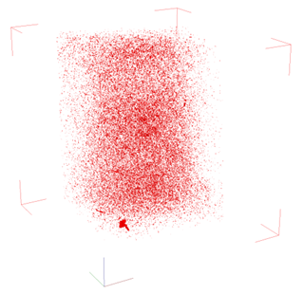
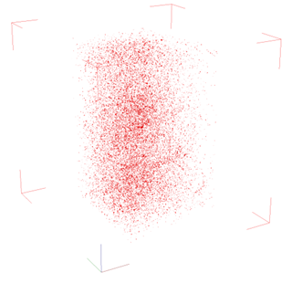
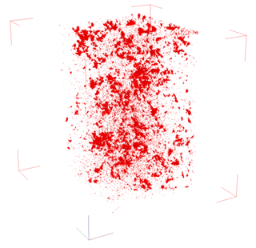
2.2 mm
1.4 mm
z
1.4 mm
12
y
x
(a) 813 K
(b) 828 K
(c) 843 K
Fig. 8 3D observation of pore properties depending on time of solid-solution treatment by fluidized bed furnace.

Slide 9
110
Salt bath
100
(480 min)
Vickers hardness, H_{v}
Fluidized
bed furnace
90
(480 min)
80
70
60
10⁻²
10⁻¹
10⁰
10¹
10²
10³
Aging time, t / ks
(a) Change in hardness during aging
280
4
260
3
σ_{UTS}, σ_{0.2} / MPa
RA (%), ε_{f}
2
240
1
σ_{UTS}
σ_{0.2}
ε_{f}
RA
220
Fluidized
bed furnace
Salt bath
0
(b) Strength and ductility
Fig. 9 Comparison of mechanical properties in the sample that is heat-treated with fluidized bed furnace and mechanical properties in the sample that is heat-treated with salt-bath and oil-bath.

Slide 10
Table 1 Effect of solid-solution treatment temperature on pore properties in fluidized bed furnace. Average diameter, number density, sphericity and volume fraction of pore obtained by quantitative analysis are listed.
Conditions | Ave. diameter (μm) | No. density (mm⁻³) | Sphericity (%) | Vol. fraction (%)
813 K - 60 min | 9.2 | 980 | 73.8 | 0.0465
828 K - 60 min | 9.0 | 236 | 74.8 | 0.0095
843 K - 60 min | 14.8 | 565 | 67.1 | 0.2847
12

